Slide 1
User Level
유기종 과장
2020. 02. 18

Slide 2
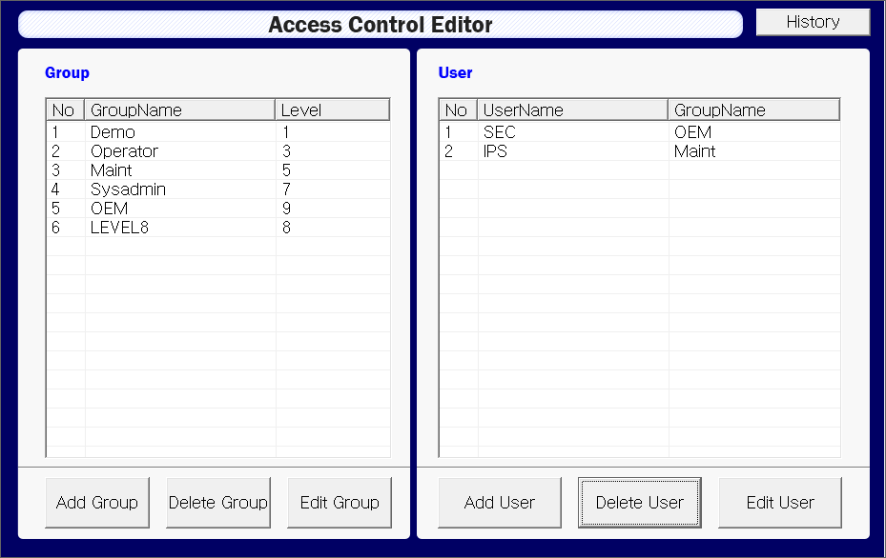
User Level
User Level Setting
WONIK Confidential

Slide 3






User Level
System Menu
1 Level
WONIK Confidential

Slide 4






User Level
Recipe Menu
1 Level
5 Level
1 Level
WONIK Confidential

Slide 5






User Level
Sevice > TM Menu
5 Level
1 Level
5 Level
WONIK Confidential

Slide 6
User Level
Sevice > PM, Auto PM Menu
5 Level
5 Level
WONIK Confidential

Slide 7






User Level
Config Menu
5 Level
1 Level
WONIK Confidential

Slide 8






User Level
Datalog Menu
1 Level
WONIK Confidential

Slide 9






User Level
Utillity Menu
5 Level
WONIK Confidential

